Slide 1
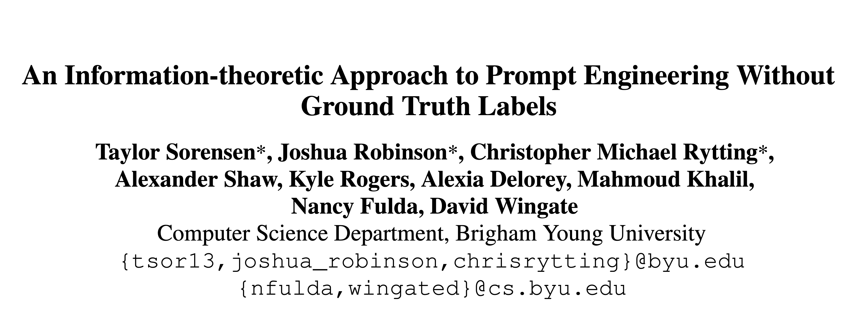
[ACL2022]

Slide 2
Task Setting
任务场景：在一个参数 unaccessible的生成模型上进行 zero-shot，如何在不使用Ground Truth 的情况下选择最佳的 prompt 提高任务性能？
由于参数 unaccessible，所以 prompt 只能是离散的，也只能进行 zero-shot 实际场景：使用 OpenAI 提供的 GPT-3 API 进行文本分类/阅读理解任务。
如果不使用 Ground Truth，则无法根据任务指标来选择 prompt。

Slide 3
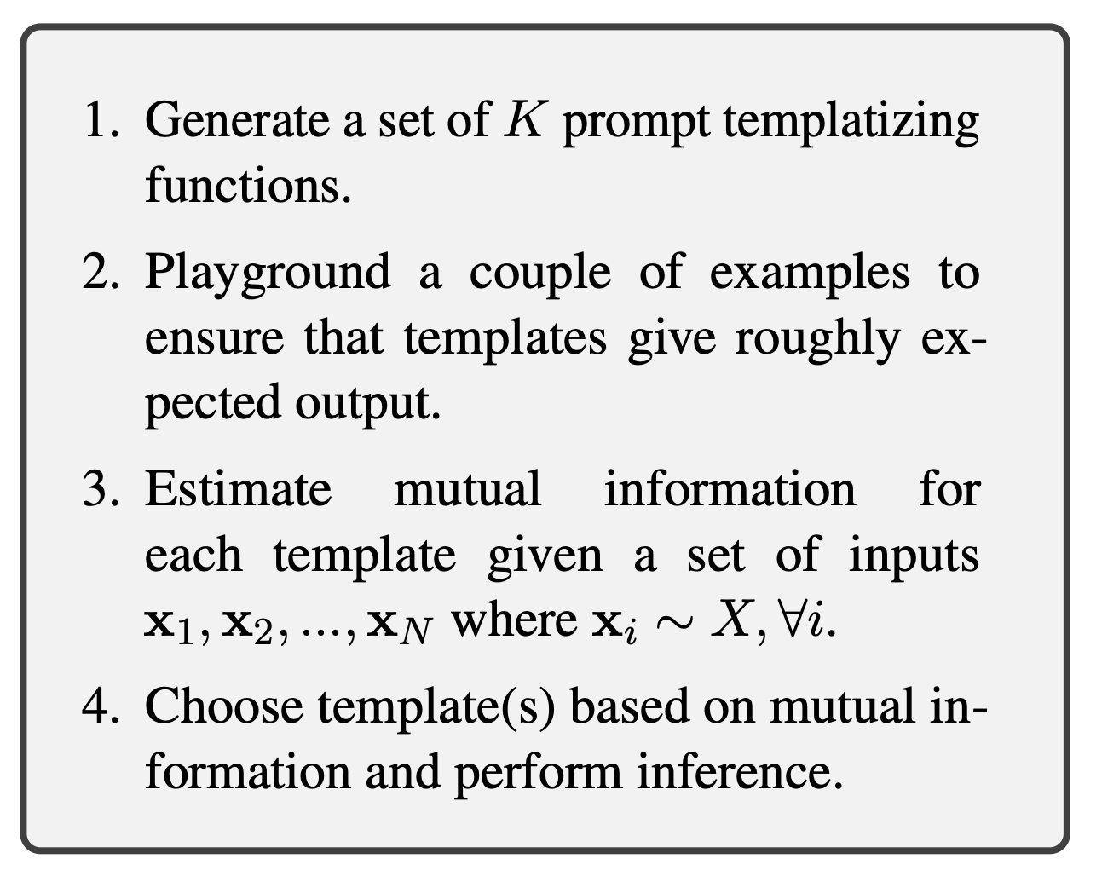
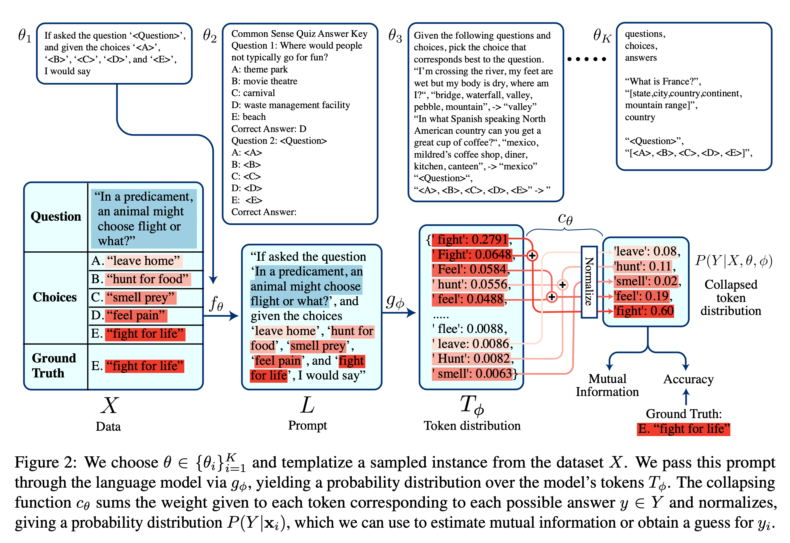
Method
$$X→L→T_{ϕ}→P(Y|X,θ,ϕ)$$

Slide 4
Pipeline
$$X→L→T_{ϕ}→P(Y|X,θ,ϕ)$$
$$f_{θ}$$
$$g_{ϕ}$$
$$c_{θ}$$
Templatizing function
Model
Collapsing function

Slide 5
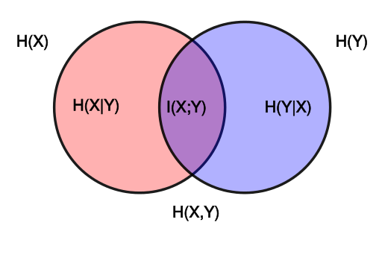
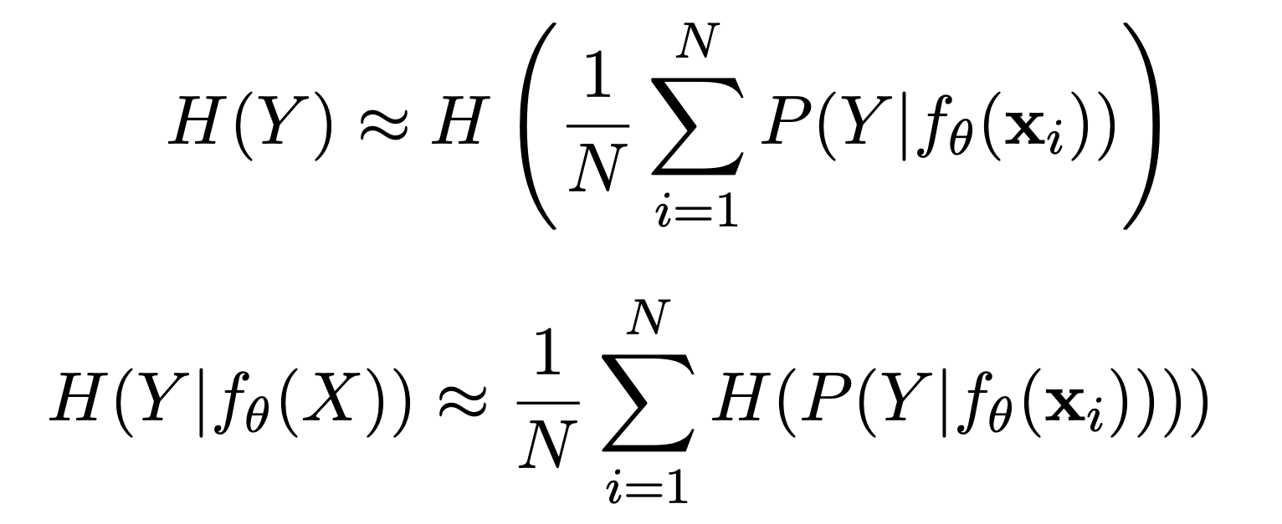
Mutual Information
Definition
$$I(X;Y)=D_{KL}(P_{(X,Y)}||P_{X}⊗P_{Y})=H(Y)-H(Y|X)$$
Criterion
$$I(f_{θ}(X);Y)=H(Y)-H(Y|f_{θ}(X))$$
$$\text{sample}x_{i}∼X$$
$$\text{select}\overset{̂}{θ}={\text{argmax}}_{θ}\{I(f_{θ}(X);Y)\}$$
$$\overset{̂}{Y}=f_{θ}(X)$$

Slide 6
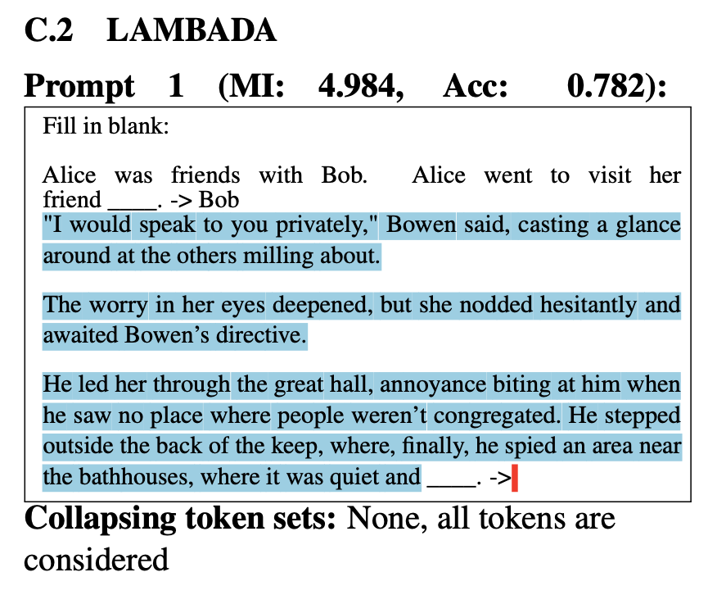
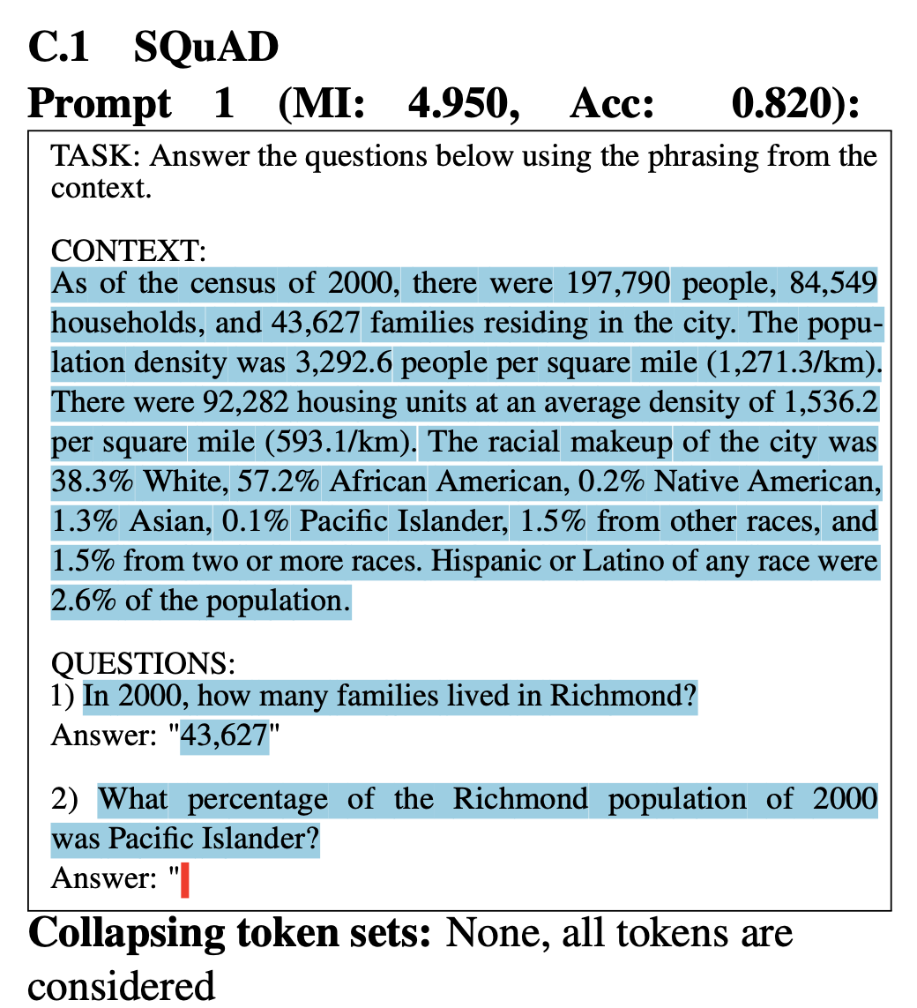
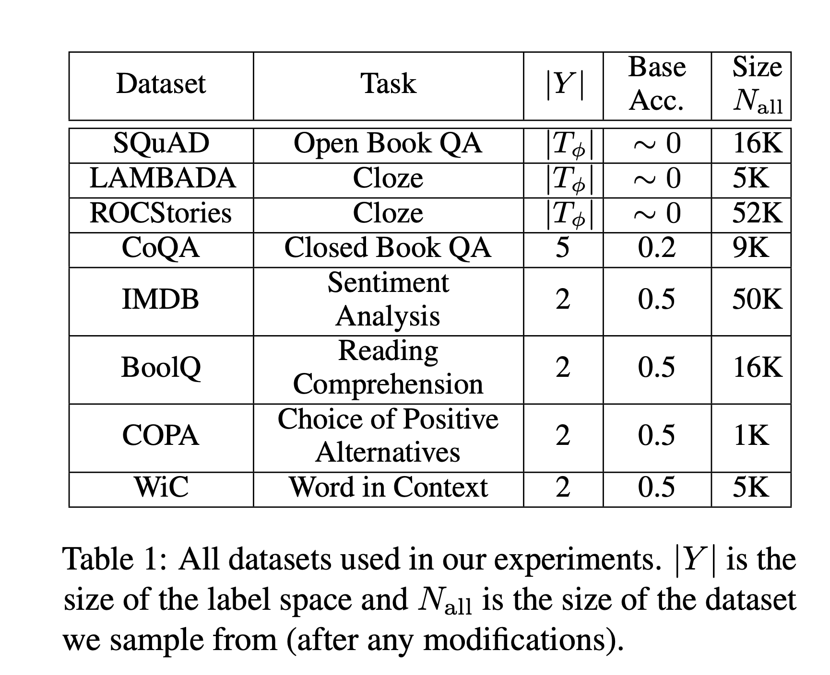
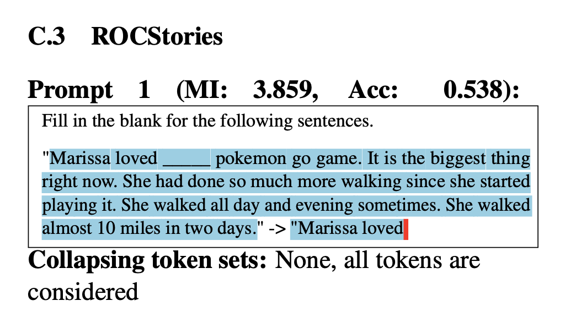
Datasets
Sample N = 500 samples from each dataset for follow-up experiments
SQuAD (Stanford Question Answering Dataset): dropped all questions that did not have a one word answer
CoQA (CommonsenseQA): dropped all questions with answer choices that started with a shared first word (e.g, the dog, the cat, the monkey)

Slide 7
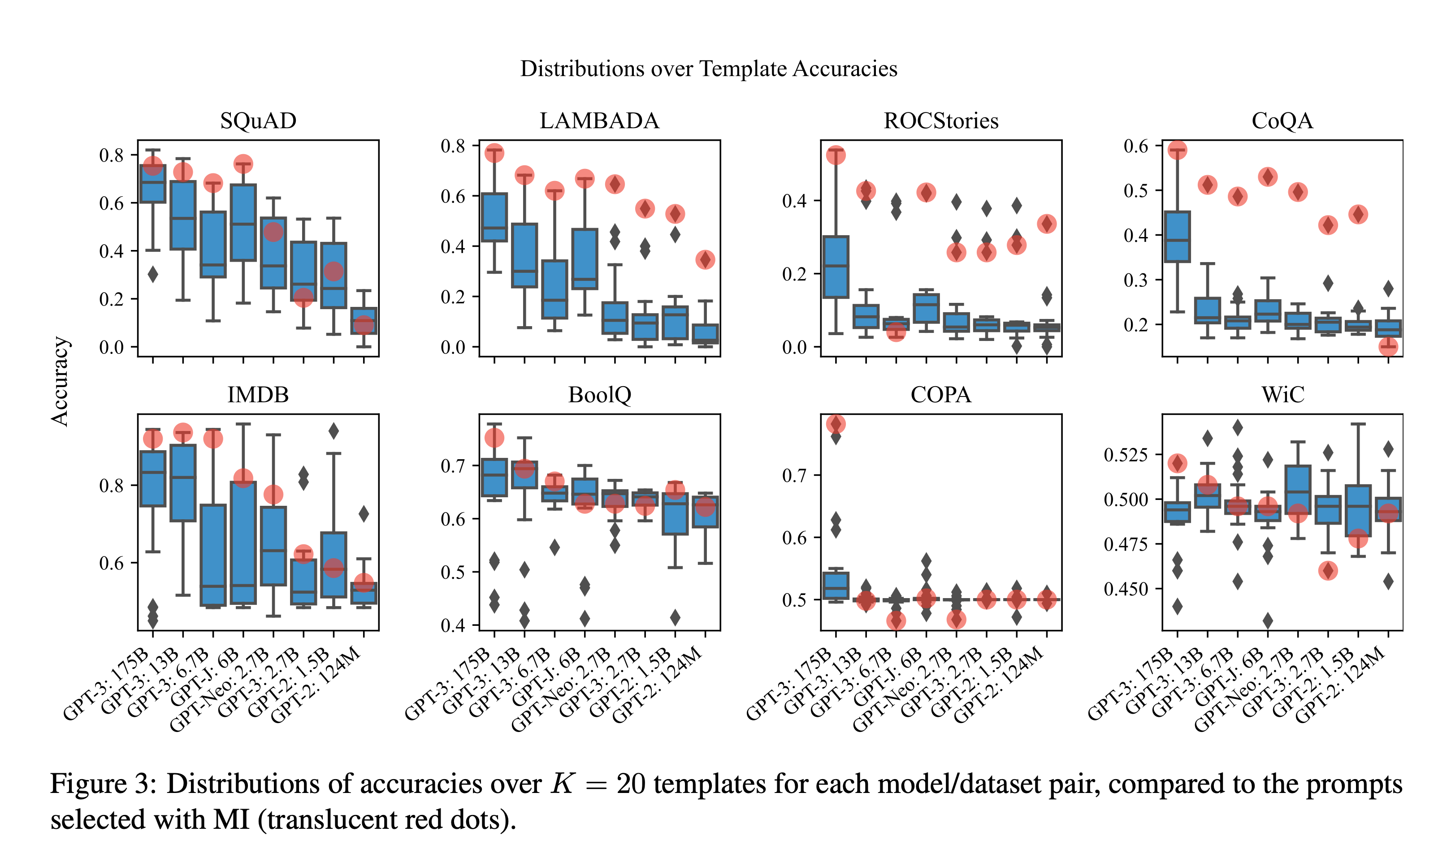
Distributions over Template Accuracies

Slide 8
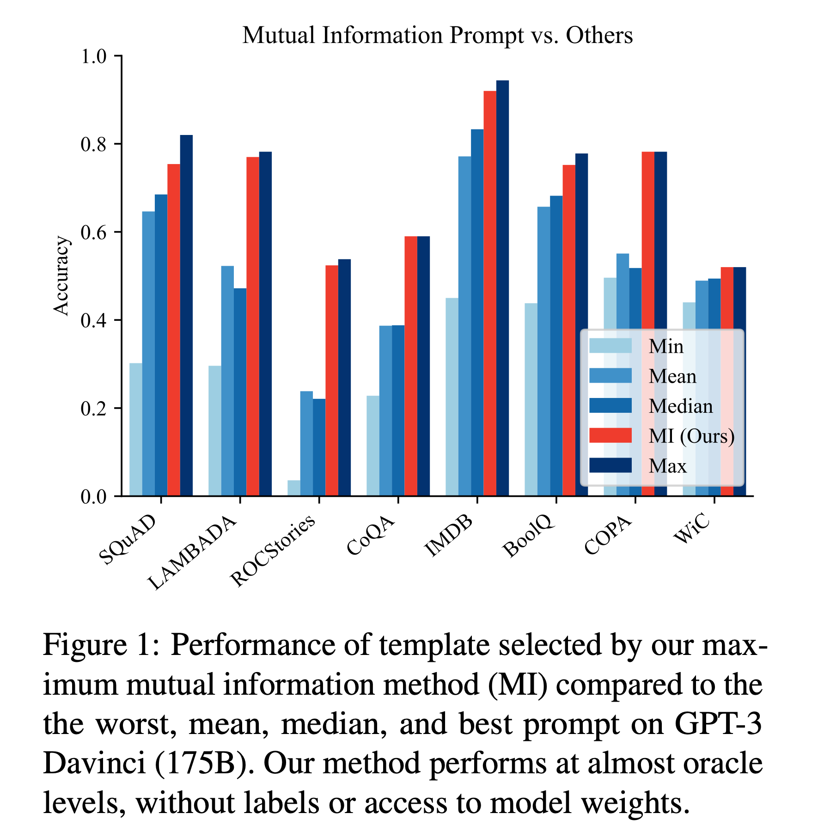
Template Selection Performance
Min: Worst Template
Mean: Random Template
Median: Median Accuracy of all Prompts
MI: Maximum Mutual Information
Max: Best Template

Slide 9
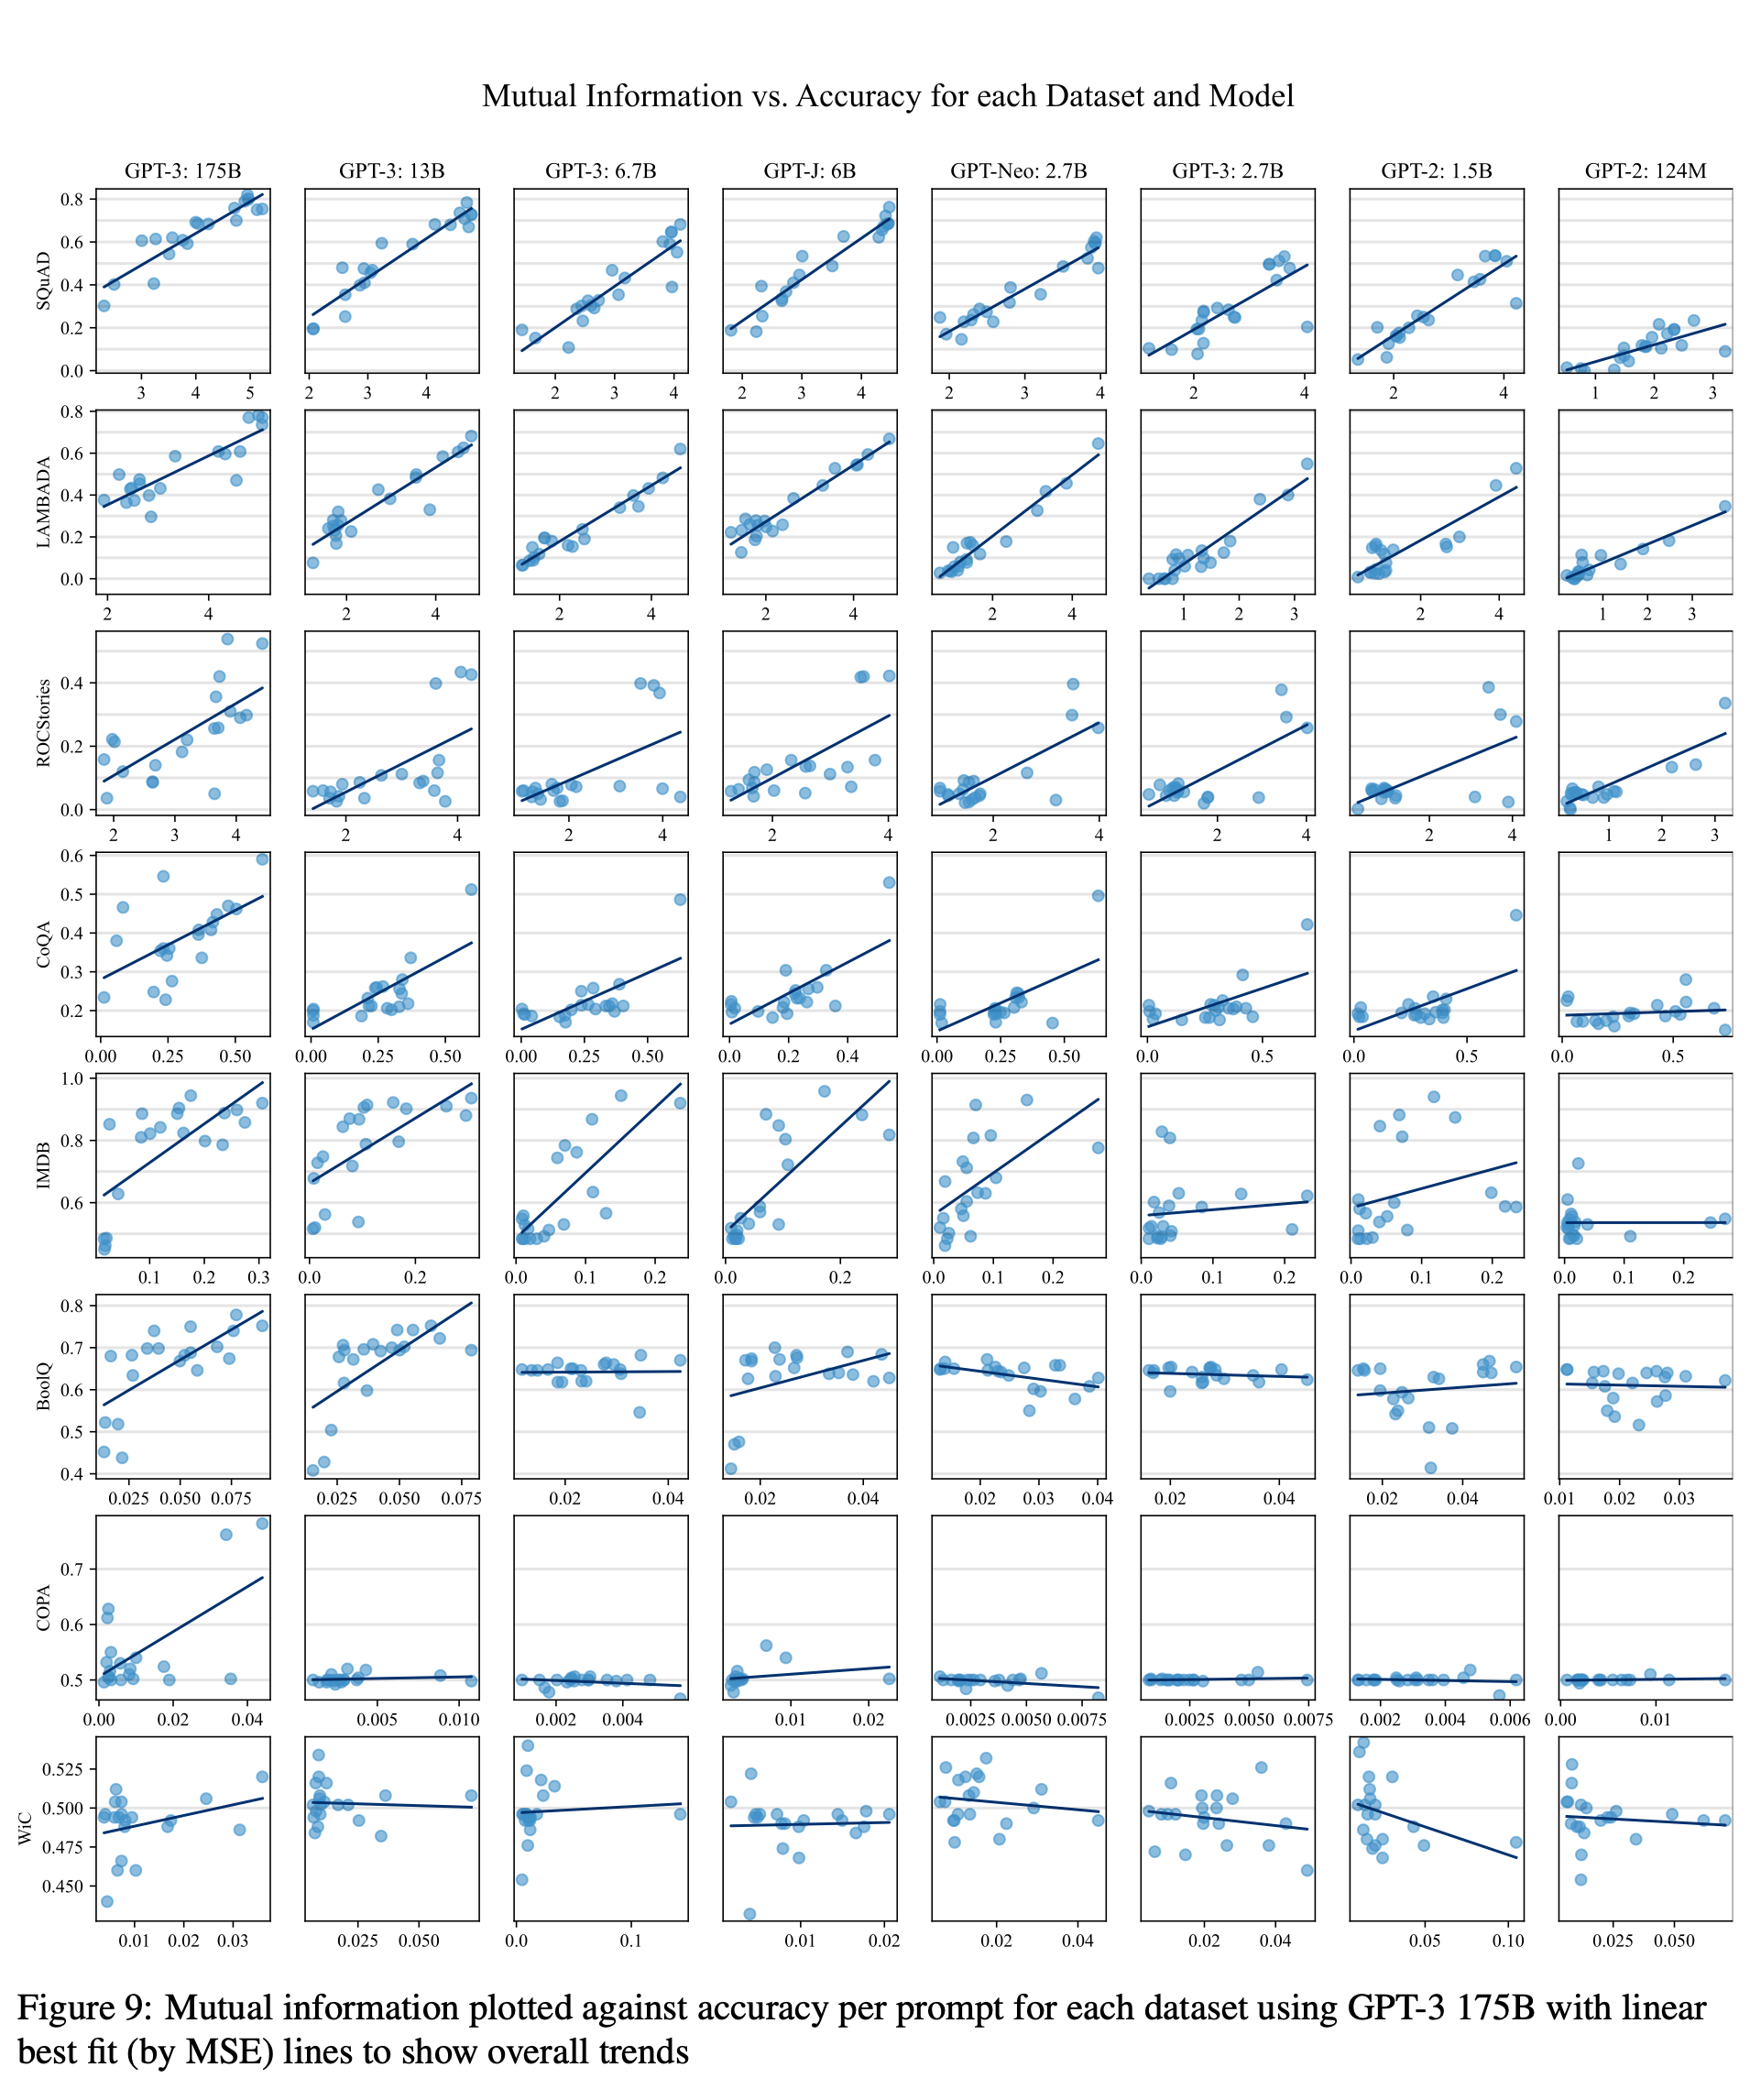
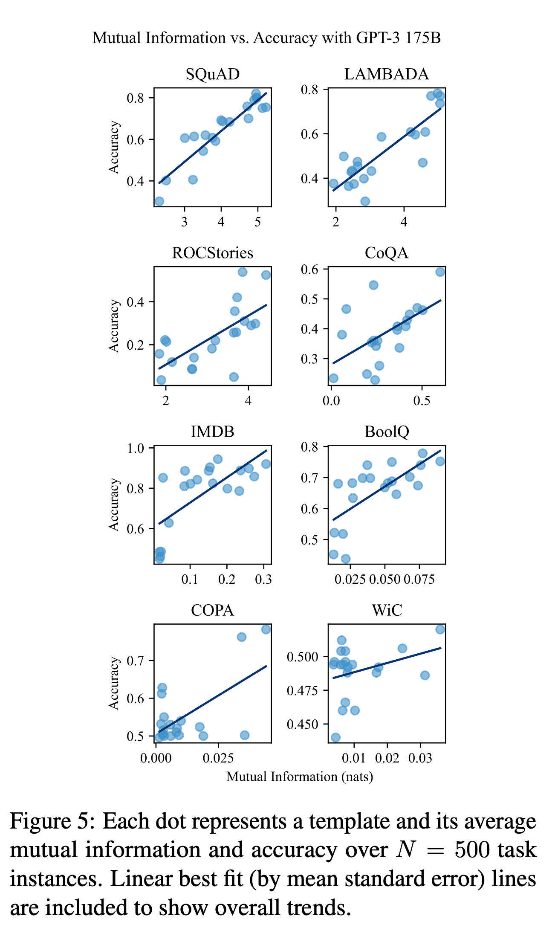
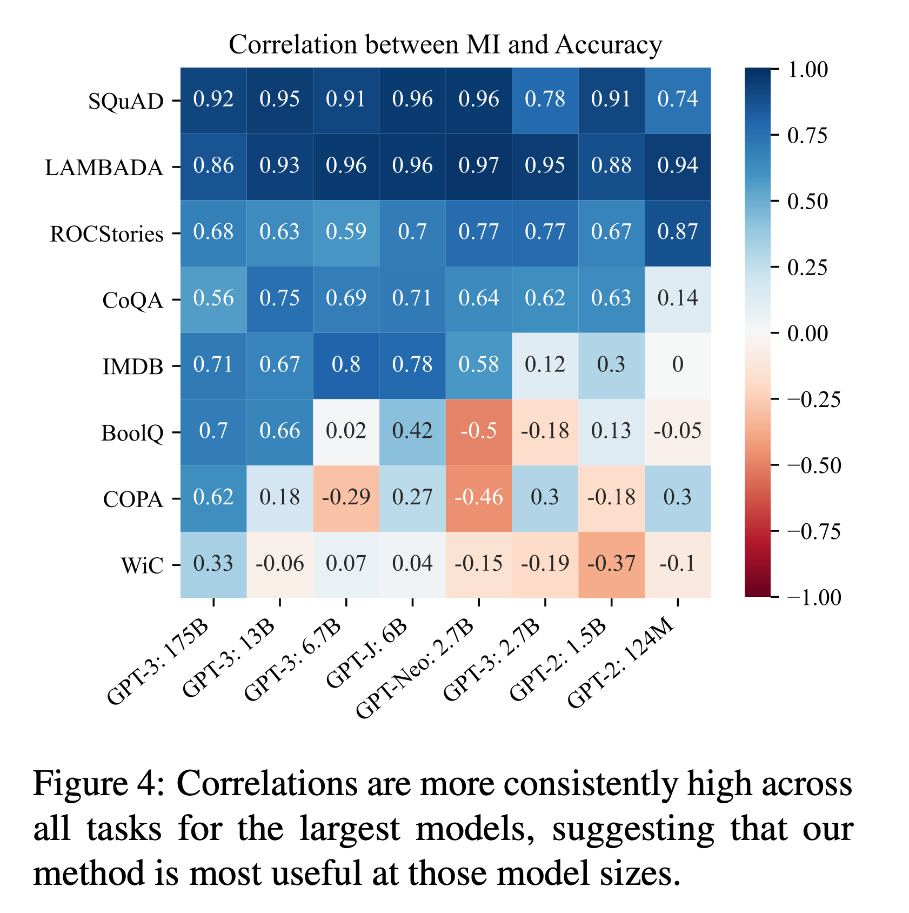
Correlation between Template Mutual Information and Accuracy
<MI, ACC> pairs -> Pearson’s R

Slide 10
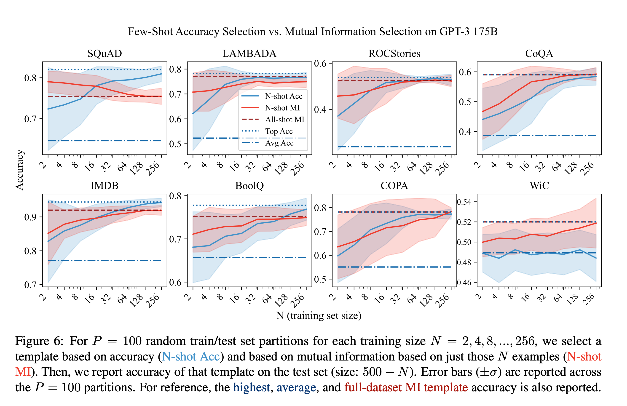
Compared to Few Labeled Examples
Questions:
How does our method compare to selecting a template based on the accuracy of a few-labeled examples?
Also, how many unlabeled examples does MI need to be able to perform well?

Slide 11
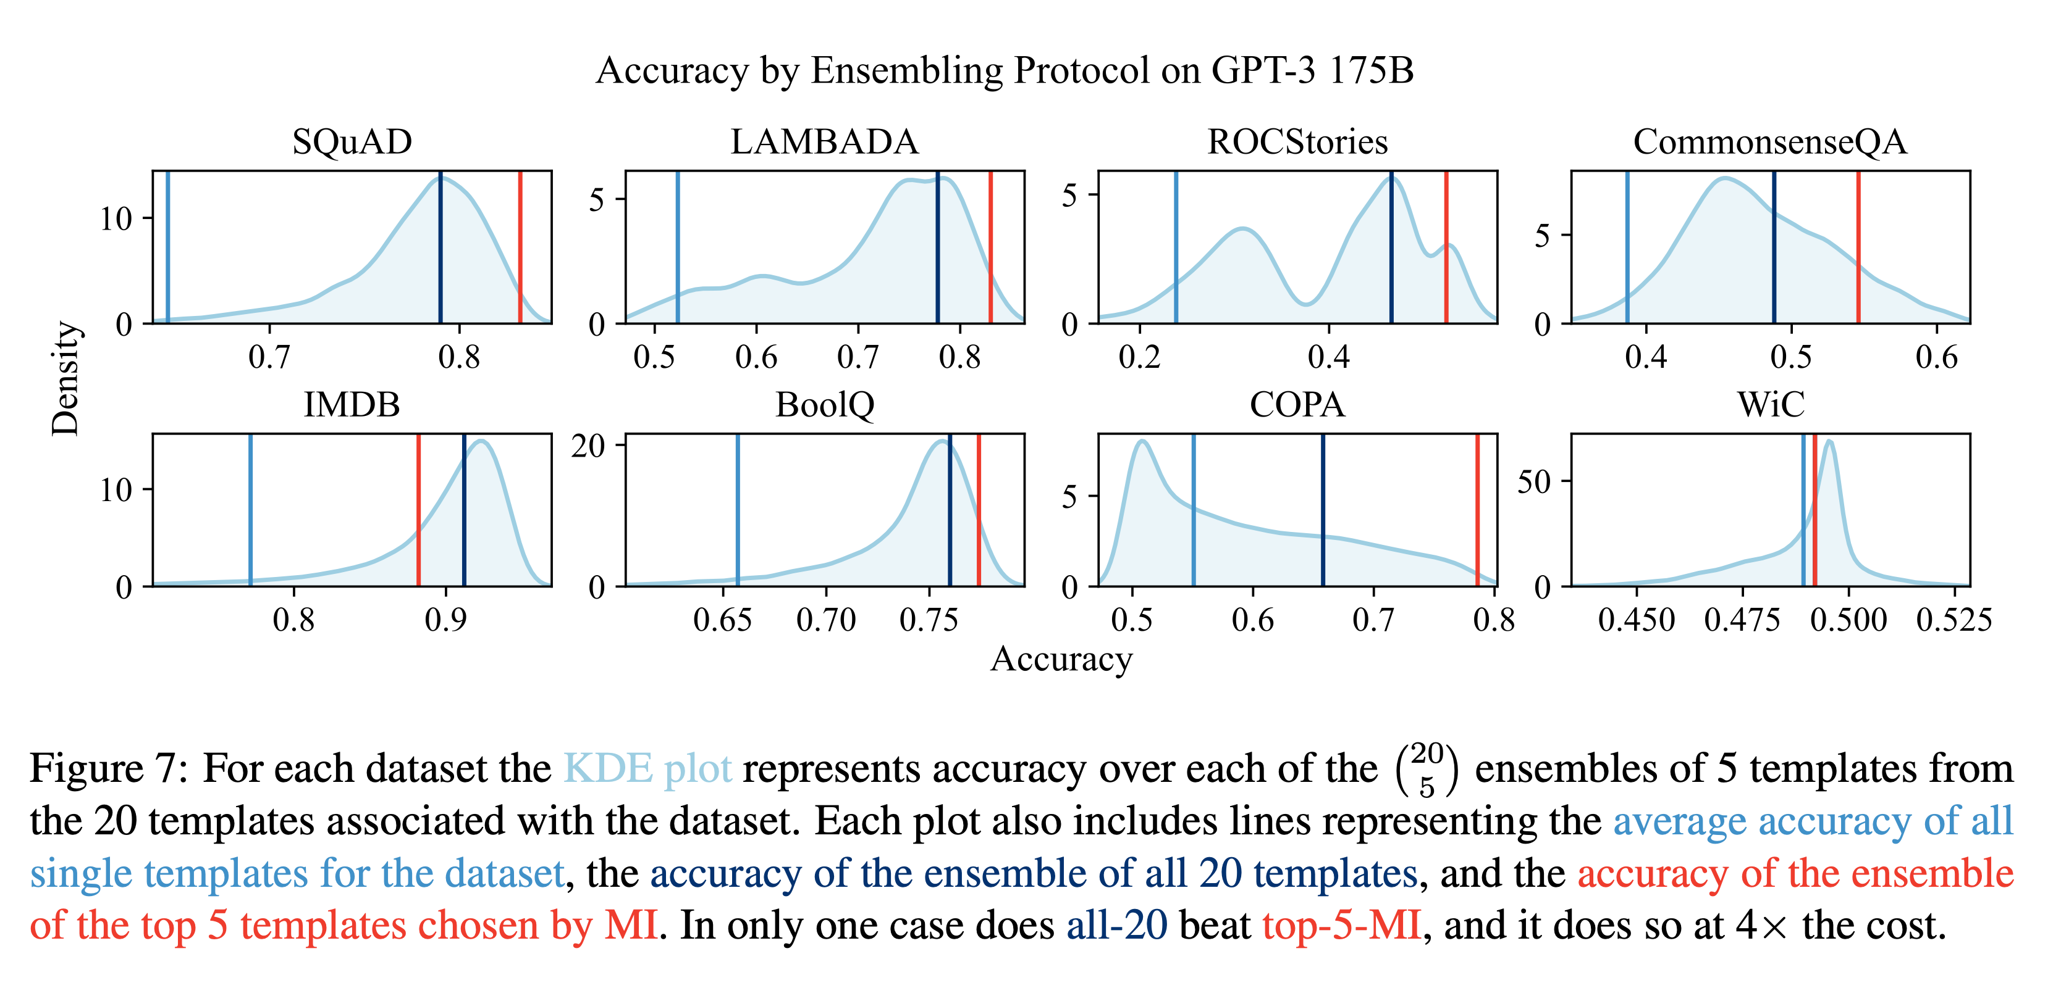
Method Robustness and Ensembling
$$\left({20 \atop 5}\right)=15,504$$

Slide 12
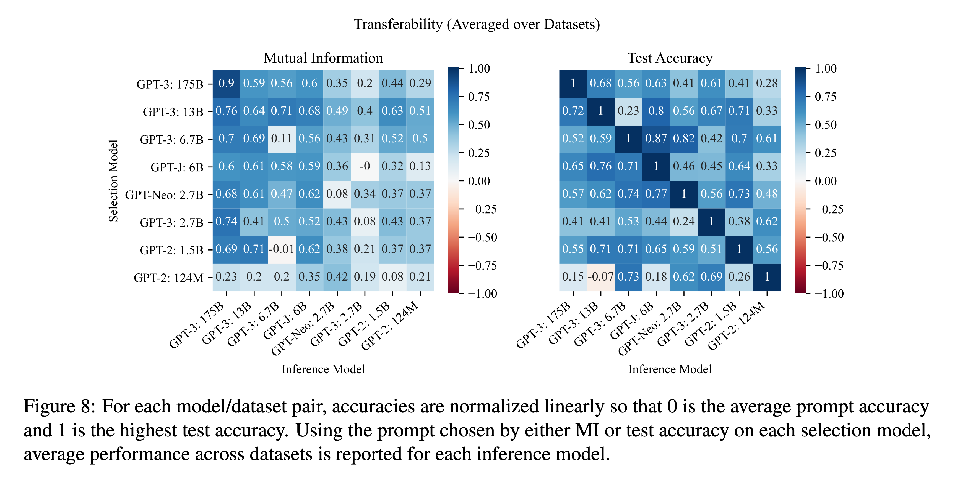
Transferability across Models
$$\text{normlization:}\frac{\text{score - mean}}{\text{max - mean}}$$

Slide 13
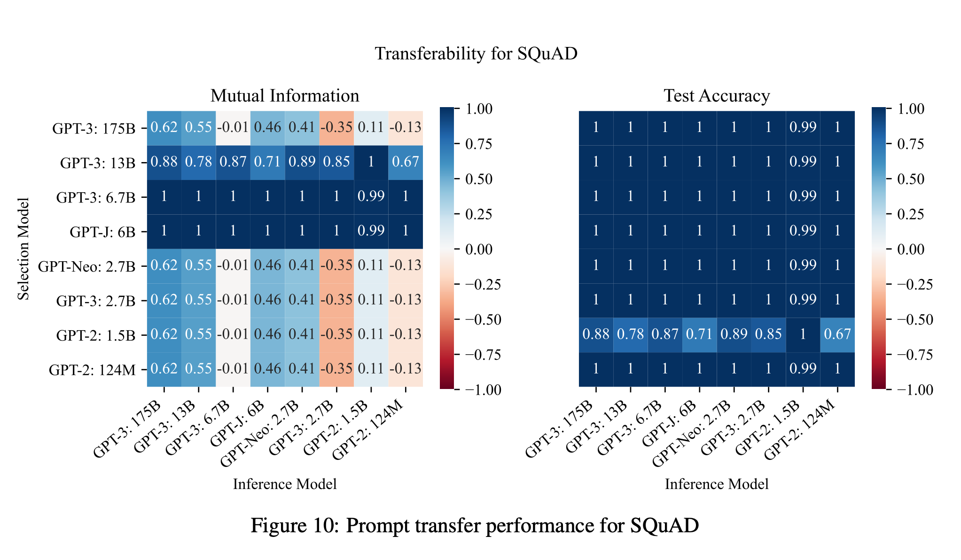
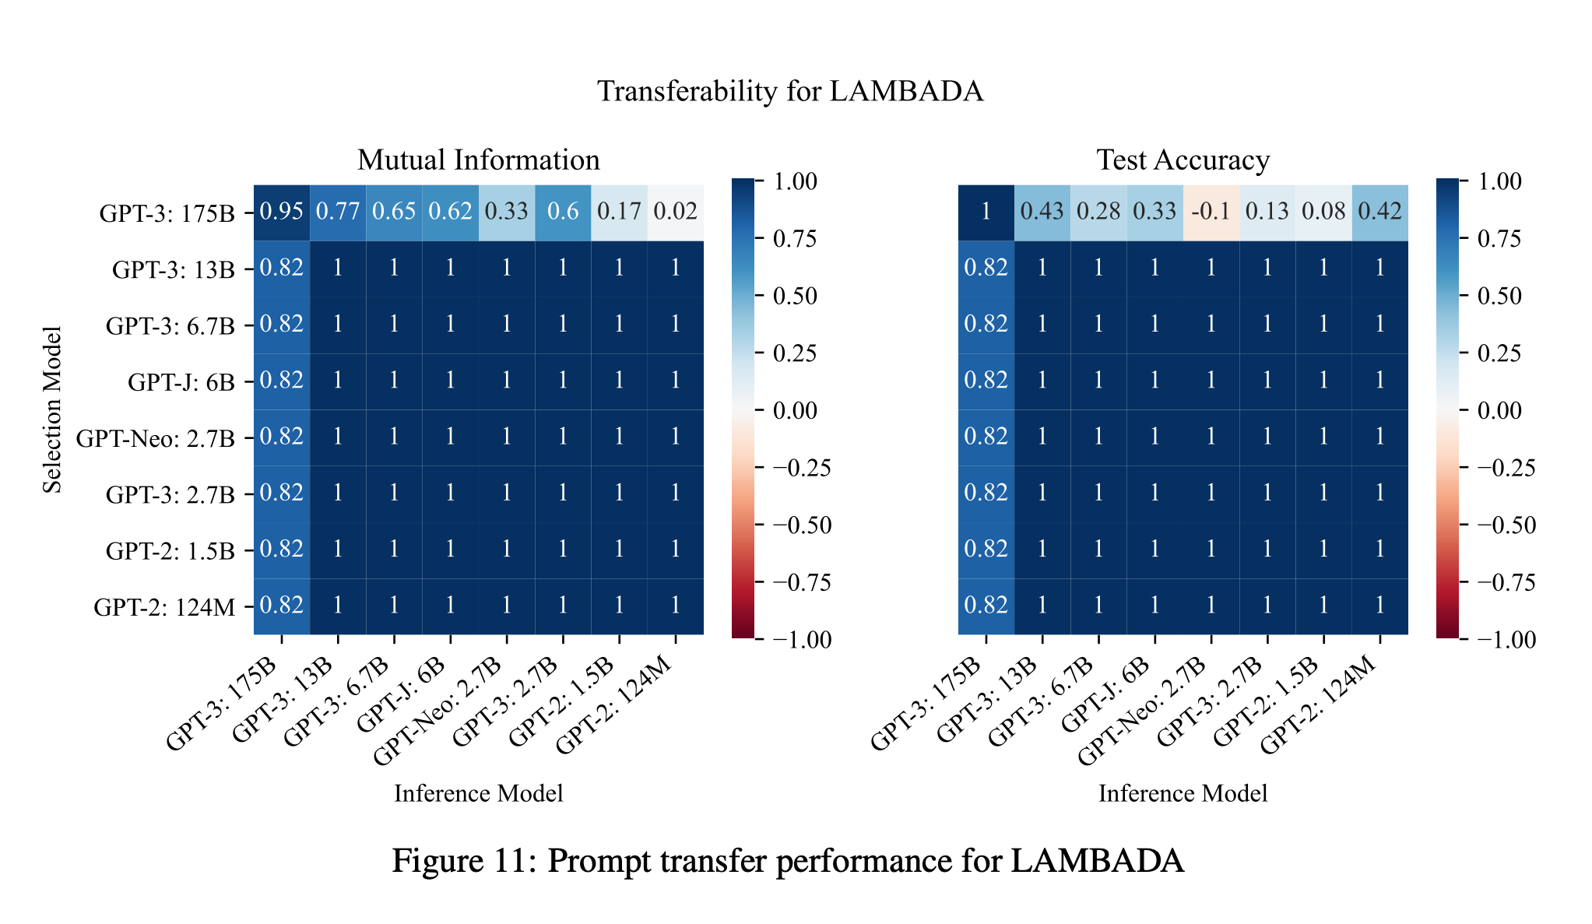
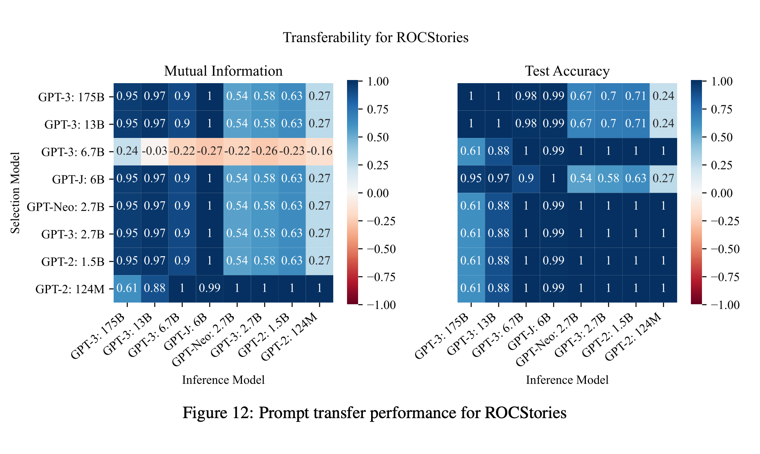
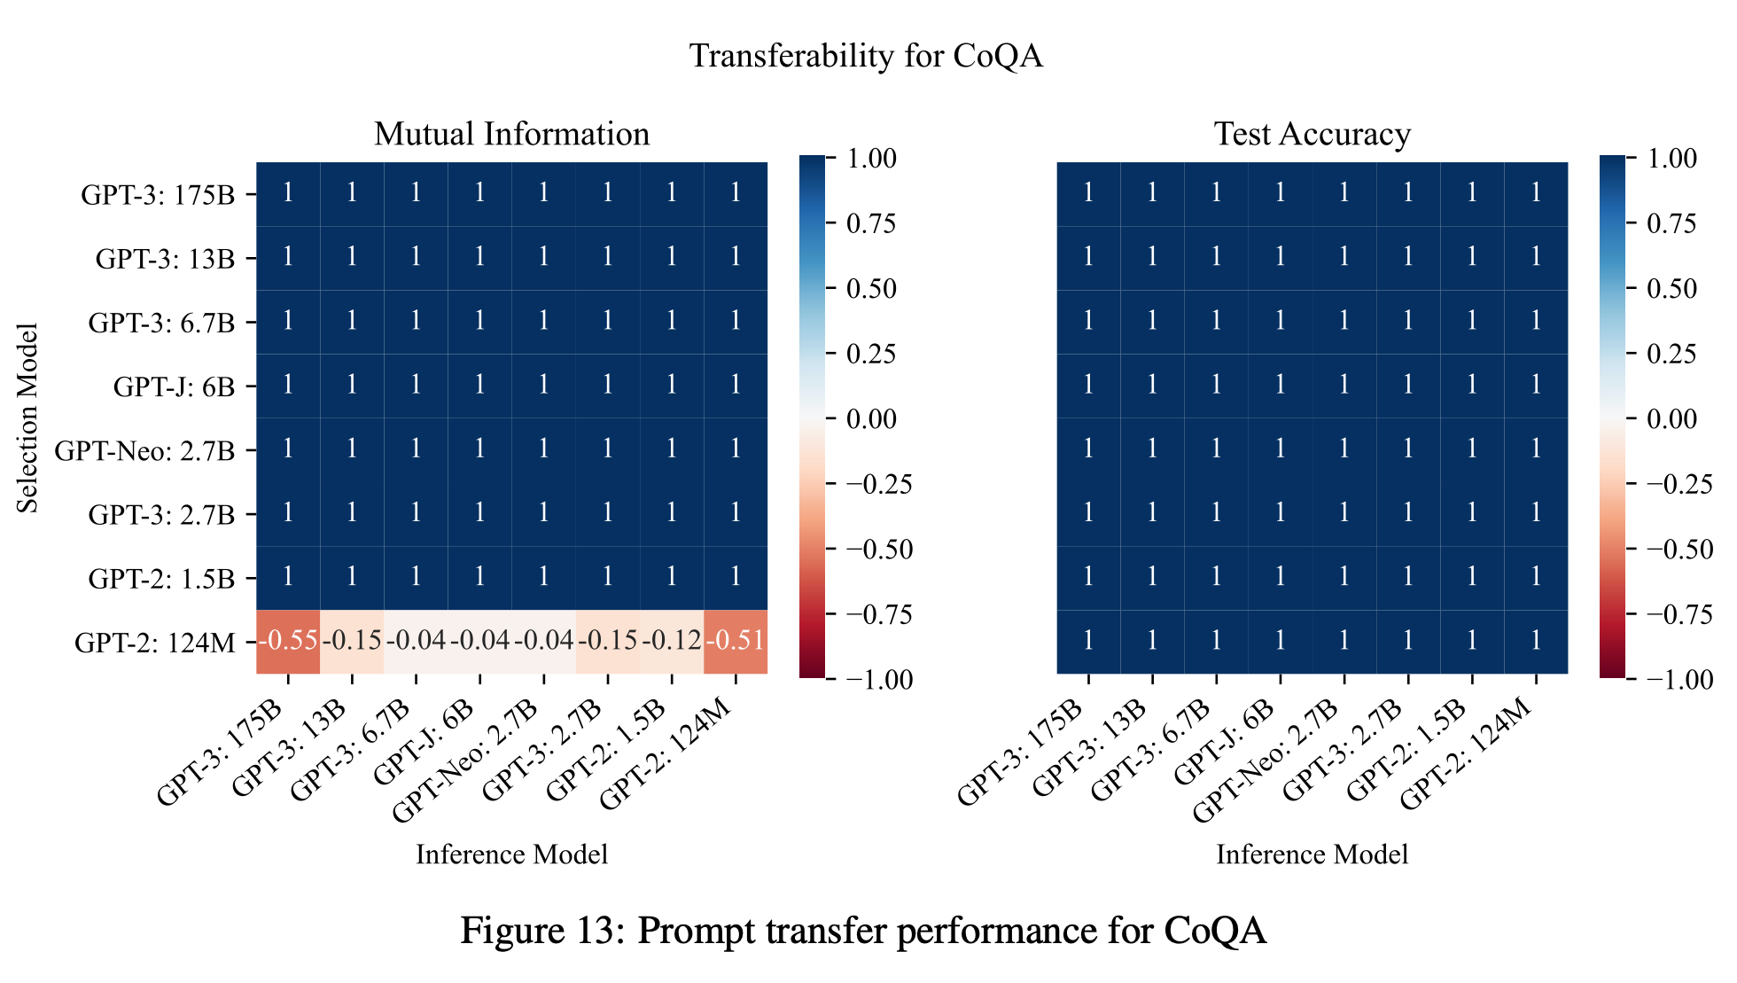

Slide 14
Summary
Introduce a methods for seleting prompts: Mutual Information
Mutual information is highly correlated with test accuracy
Selecting a prompt based on mutual information leads to significant accuracy gains over random choice
Don’t rely on ground truth labels and/or direct model access

Slide 15
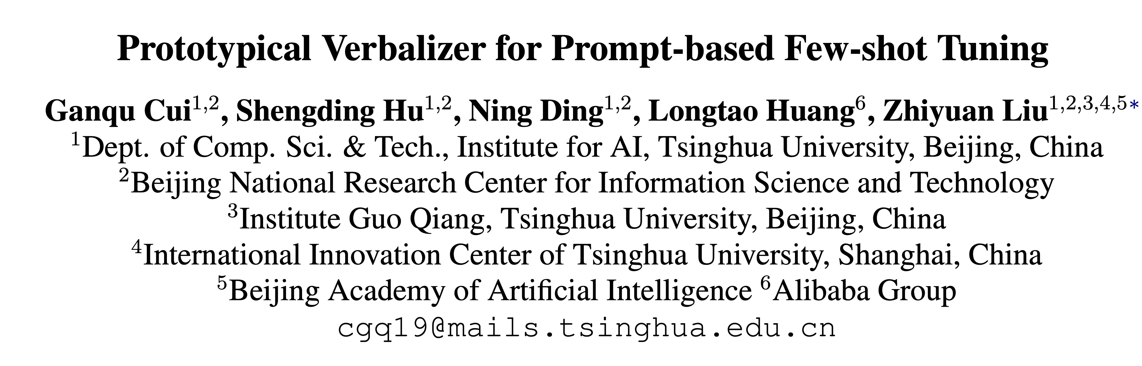
[ACL2022]

Slide 16
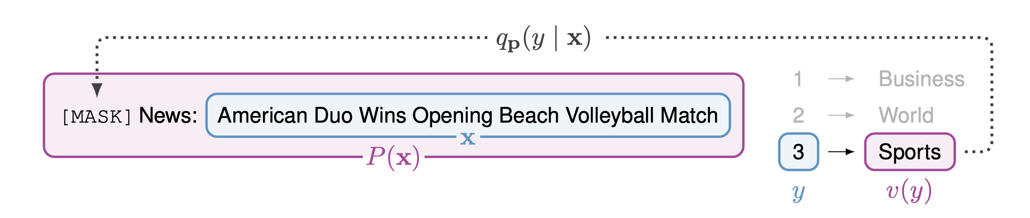
Verbalizer
How to get this？
Search-based Verbalizer
Soft Verbalizer
Manual Verbalizer
World: Taliban, Iraq, Afghan, militants, rebellion
Sport: ball, ESPN, baseball, Fifa, Sports
Business: Dow, dividend, investing, markets
Sci/Tech: Vault, IBM, Qualcomm, Technologies
AG’s News

Slide 17
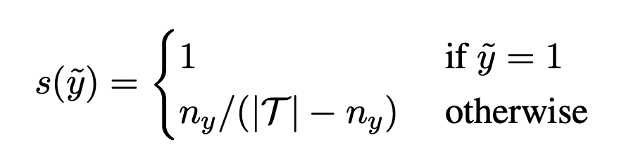
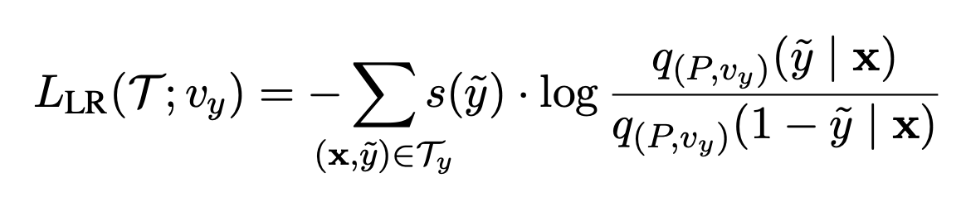
PETAL
Search-based Verbalizer
0
Non-Sport
1
暴力做法：为每个类别从词表中随机选择一个token，计算这组token的整体得分（e.g. Accuracy）
时间复杂度：$O(|T|^{k})$
Sport / non-Sport
Tricks:
Balance factor for label imbalance
Likelihood Ratio.
PETAL: 分别为每个类别搜索 token, 计算每个token在区分这个类上得分（e.g. Accuracy）
时间复杂度：$O(k|T|)$

Slide 18
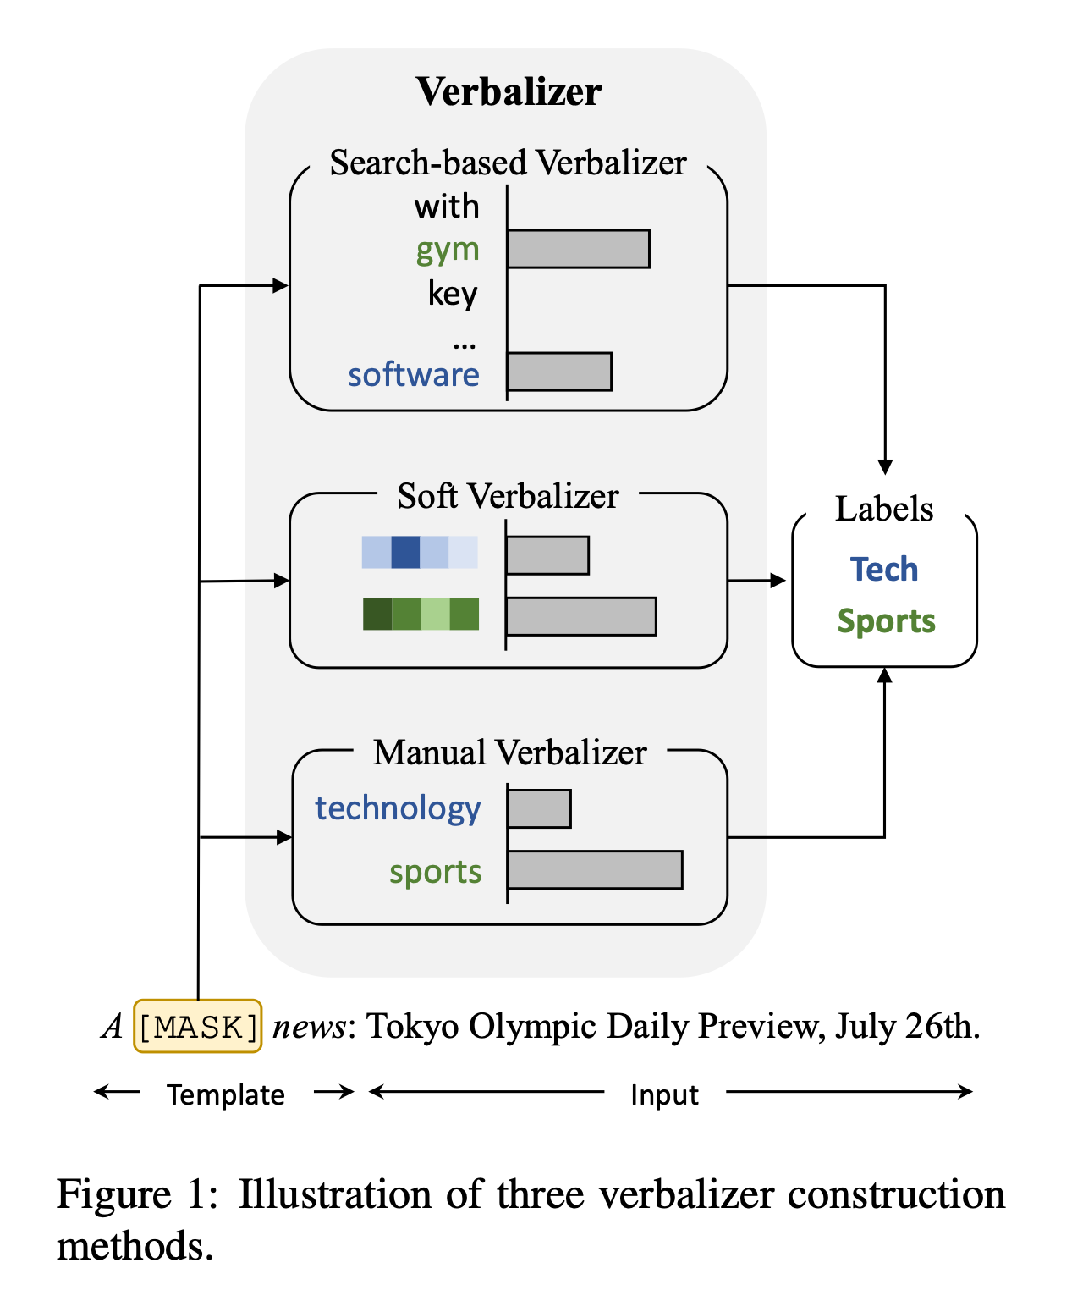
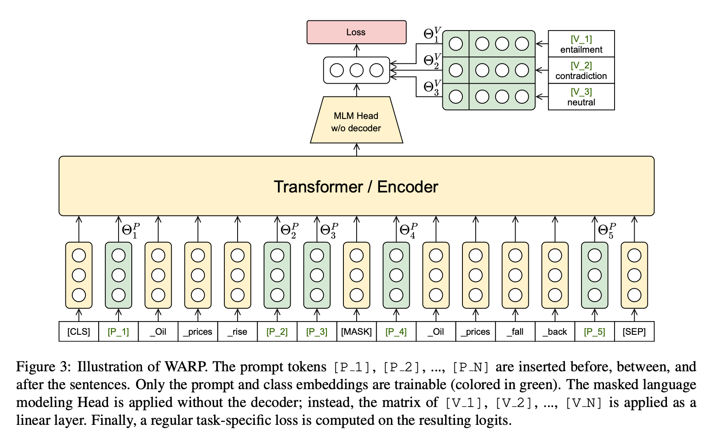
WARP
Summary
Soft Verbalizer
Search-based: 通过搜索得到每个类别对应的token，往往需要搜索整个词表。
Soft(DART): prompt为连续 embeddings，为每个类从 unused tokens 中挑一个作为[MASK]的预测目标。
Manual: 手工设计每个类别对应的token，需要专家知识。

Slide 19
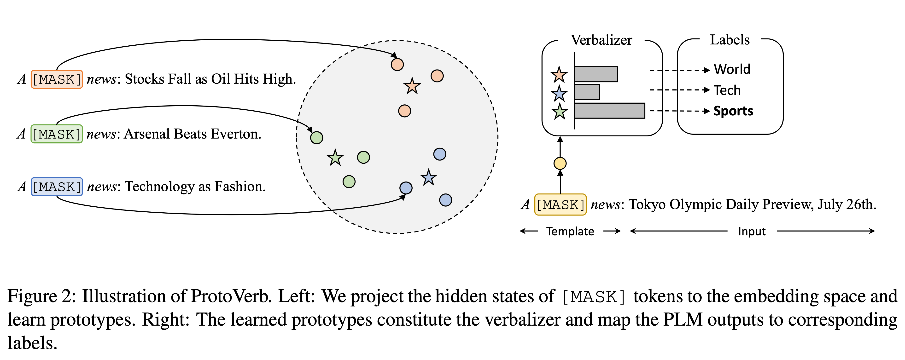
Illustration of ProtoVerb

Slide 20
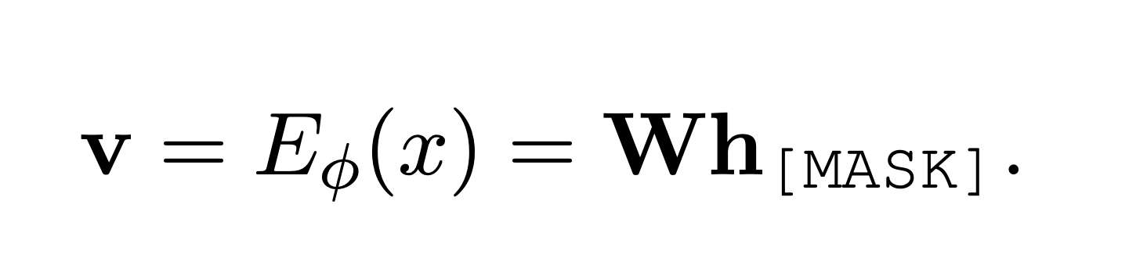
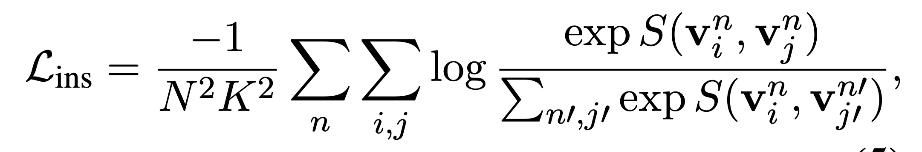
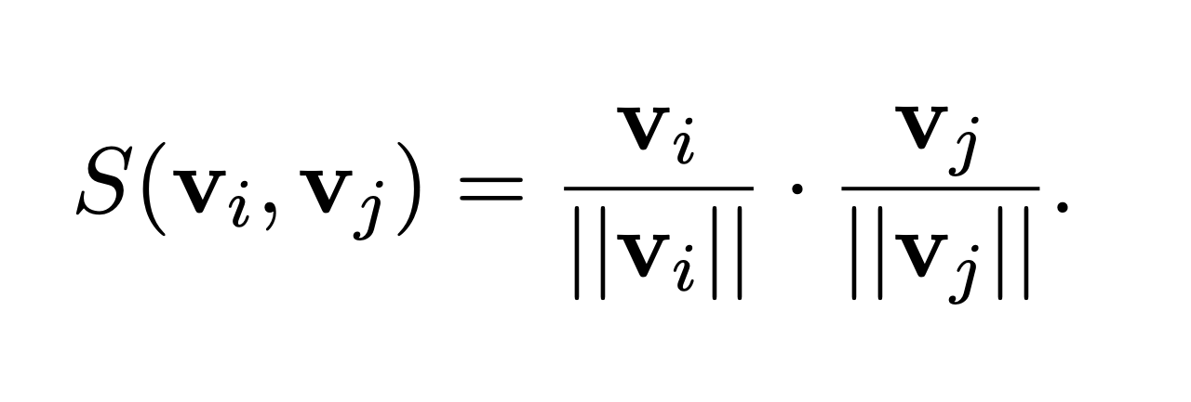
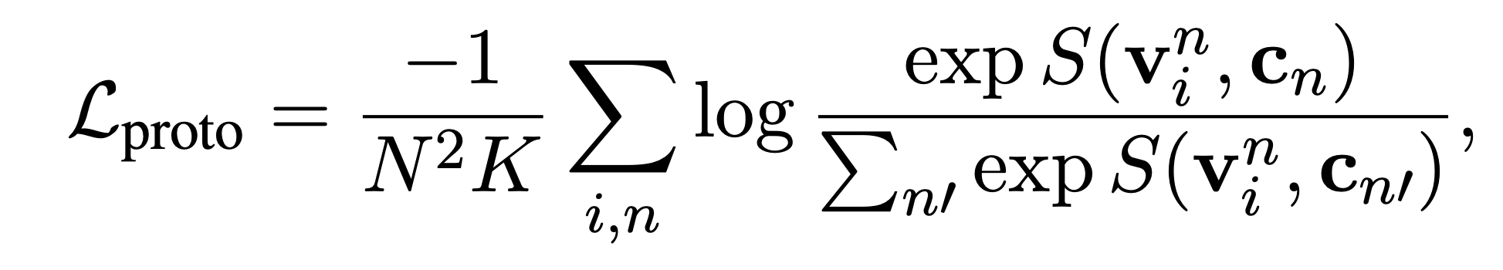
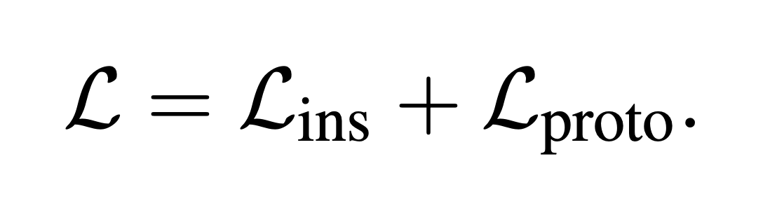
Training
N-way-K-shot
Instance Representation
Cosine Similarity

Slide 21
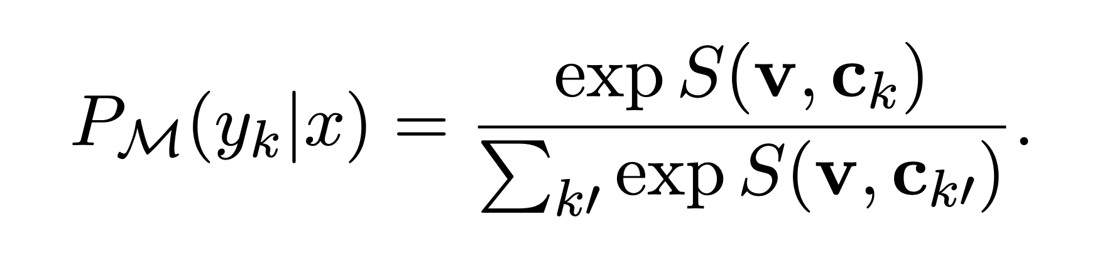
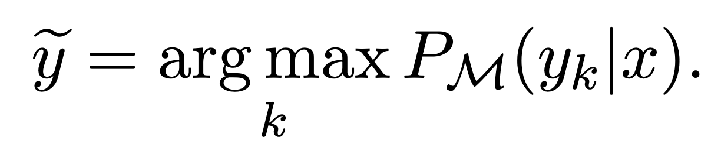
Inference

Slide 22
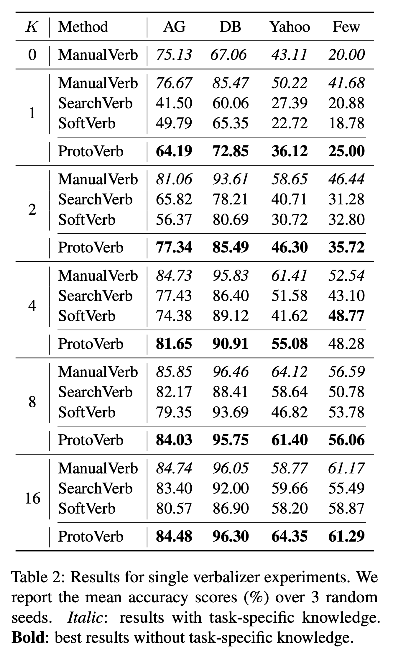
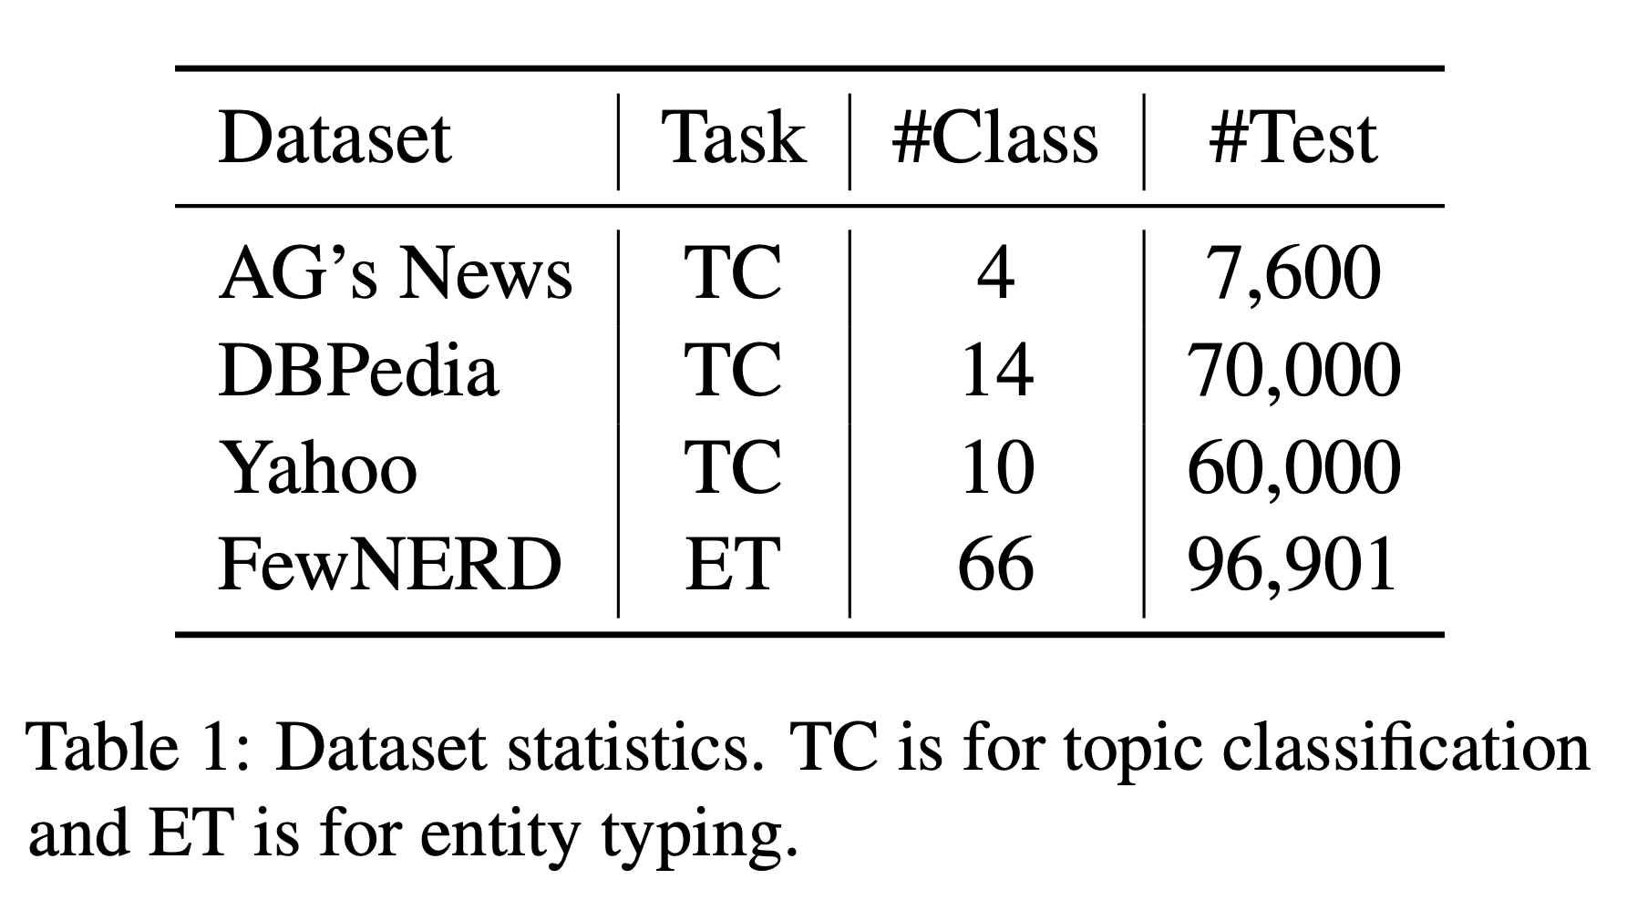
Results for
single verbalizer

Slide 23
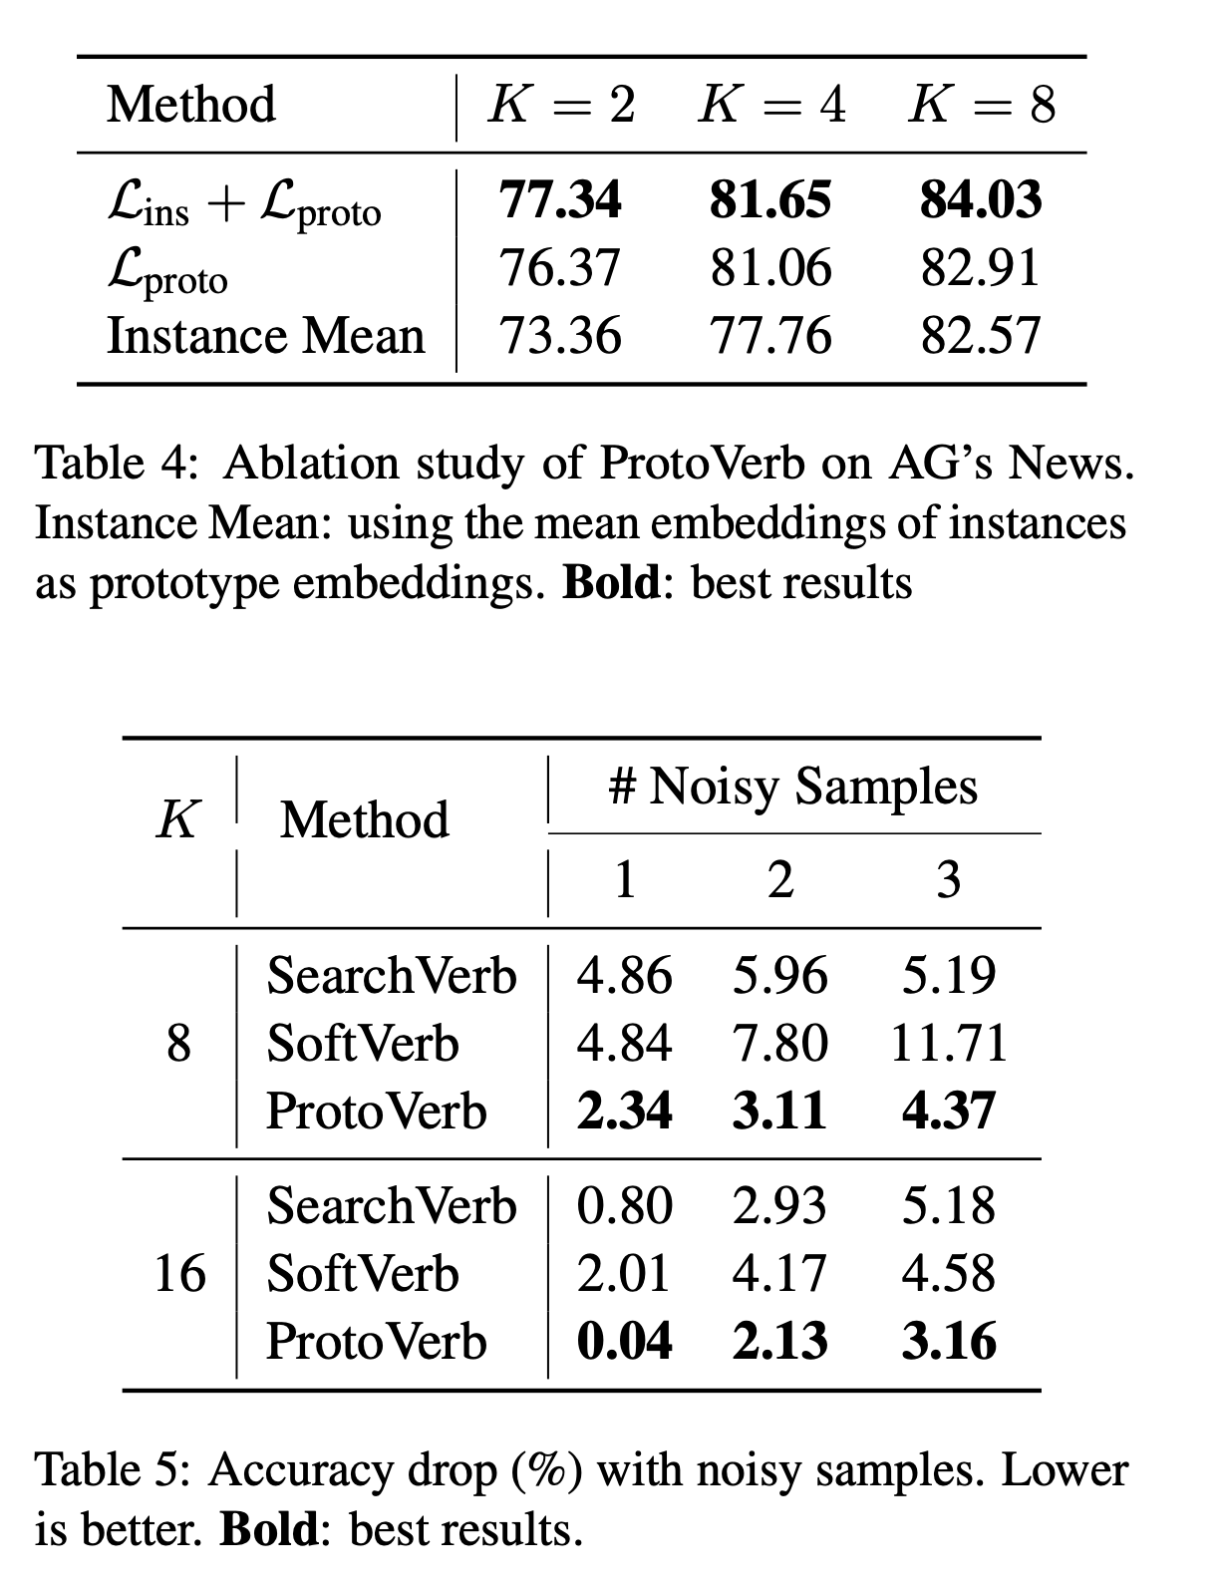
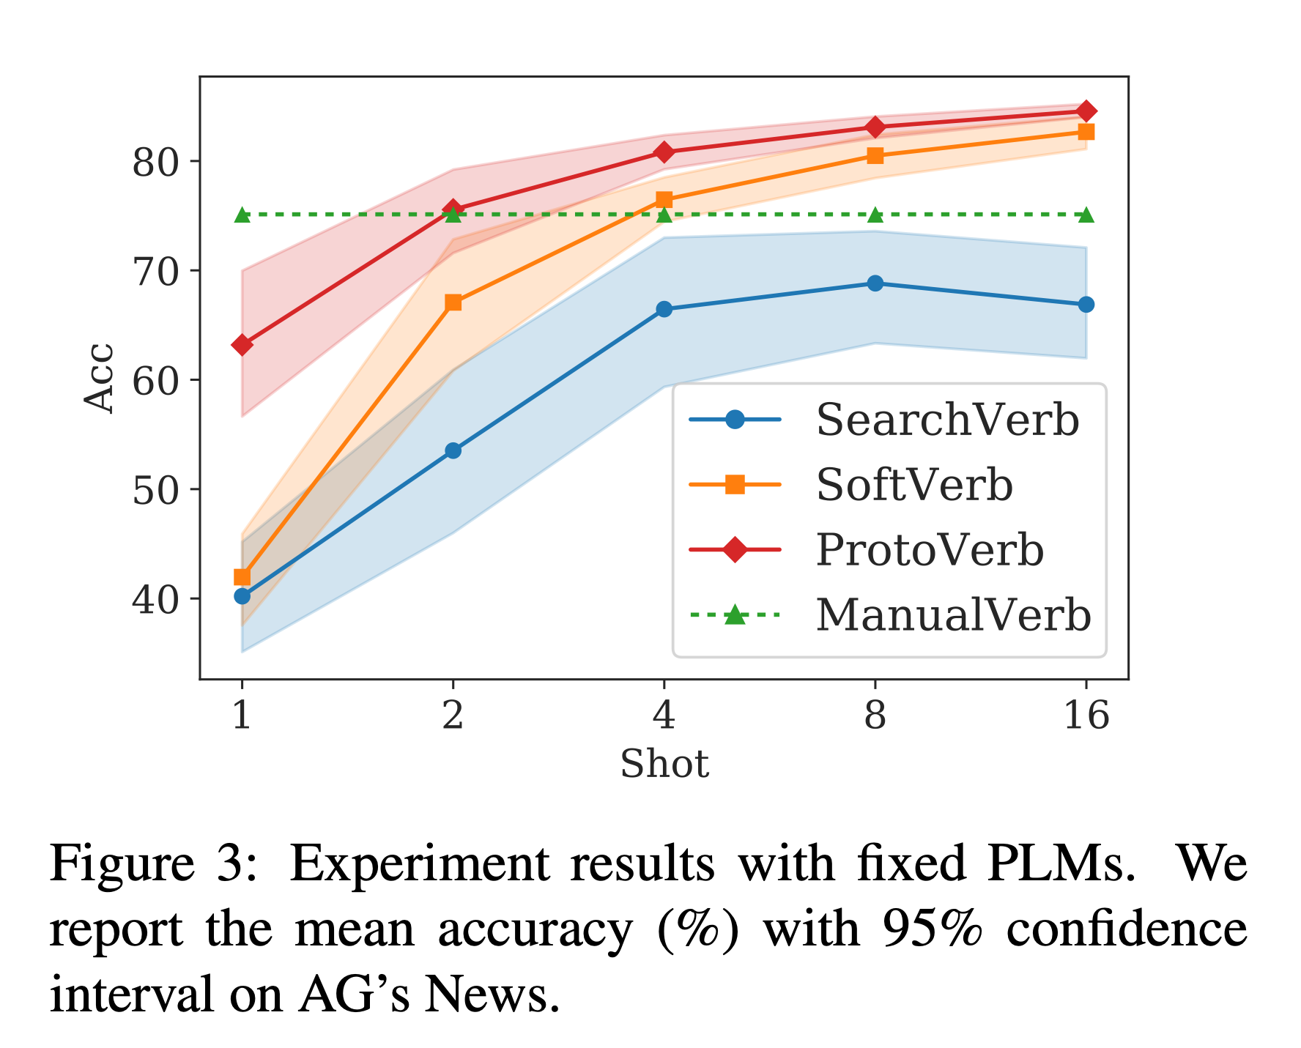
Analysis
Ablation Study &
Robustness on Noisy Samples
Fixed Model Experiments

Slide 24
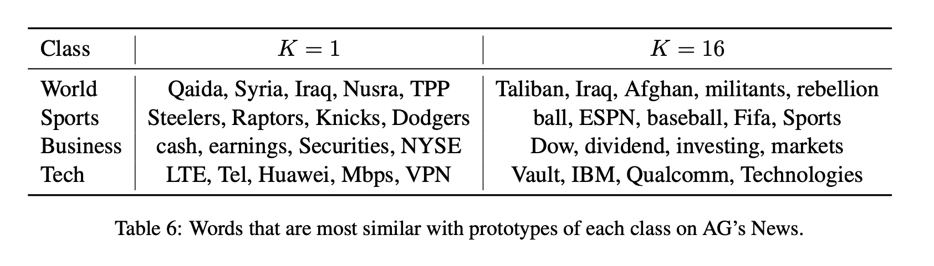
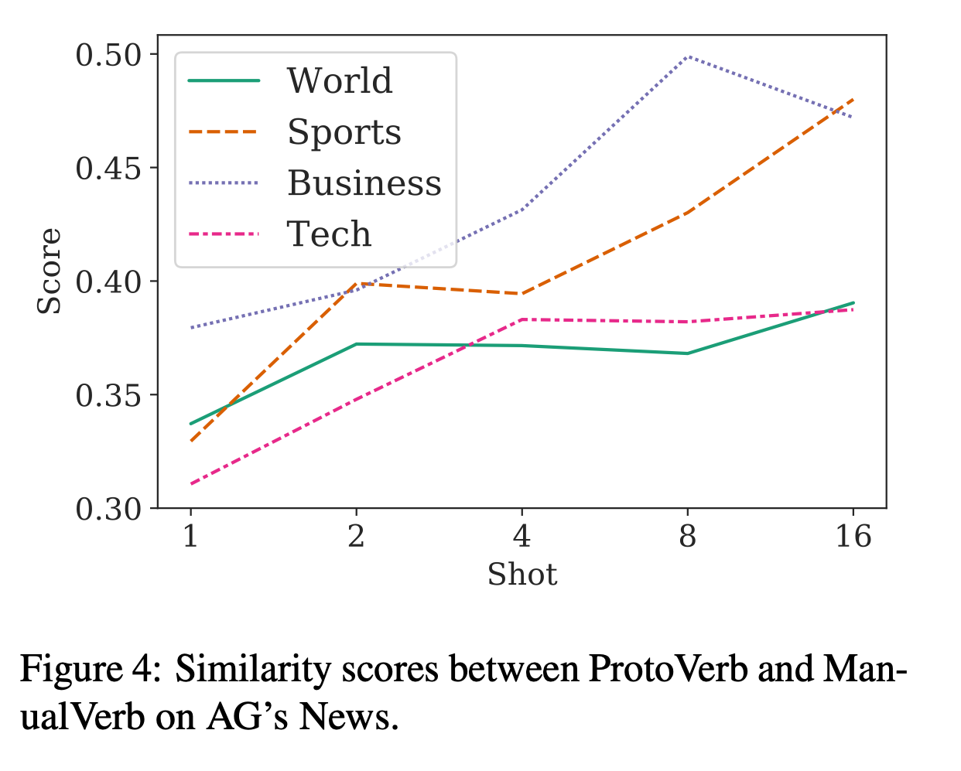
Analysis
Prototype Discretization
Is ProtoVerb Similar
with ManualVerb?

